Slide 1
UNIT 4 –Data stream
Data stream refers to the continuous flow of data generated by various sources in real-time.

Slide 2
UNIT 4 –Data stream Model
The data stream model is designed to handle large, continuous, and rapidly arriving data, focusing on real-time, memory-efficient, and approximate computation.

Slide 3
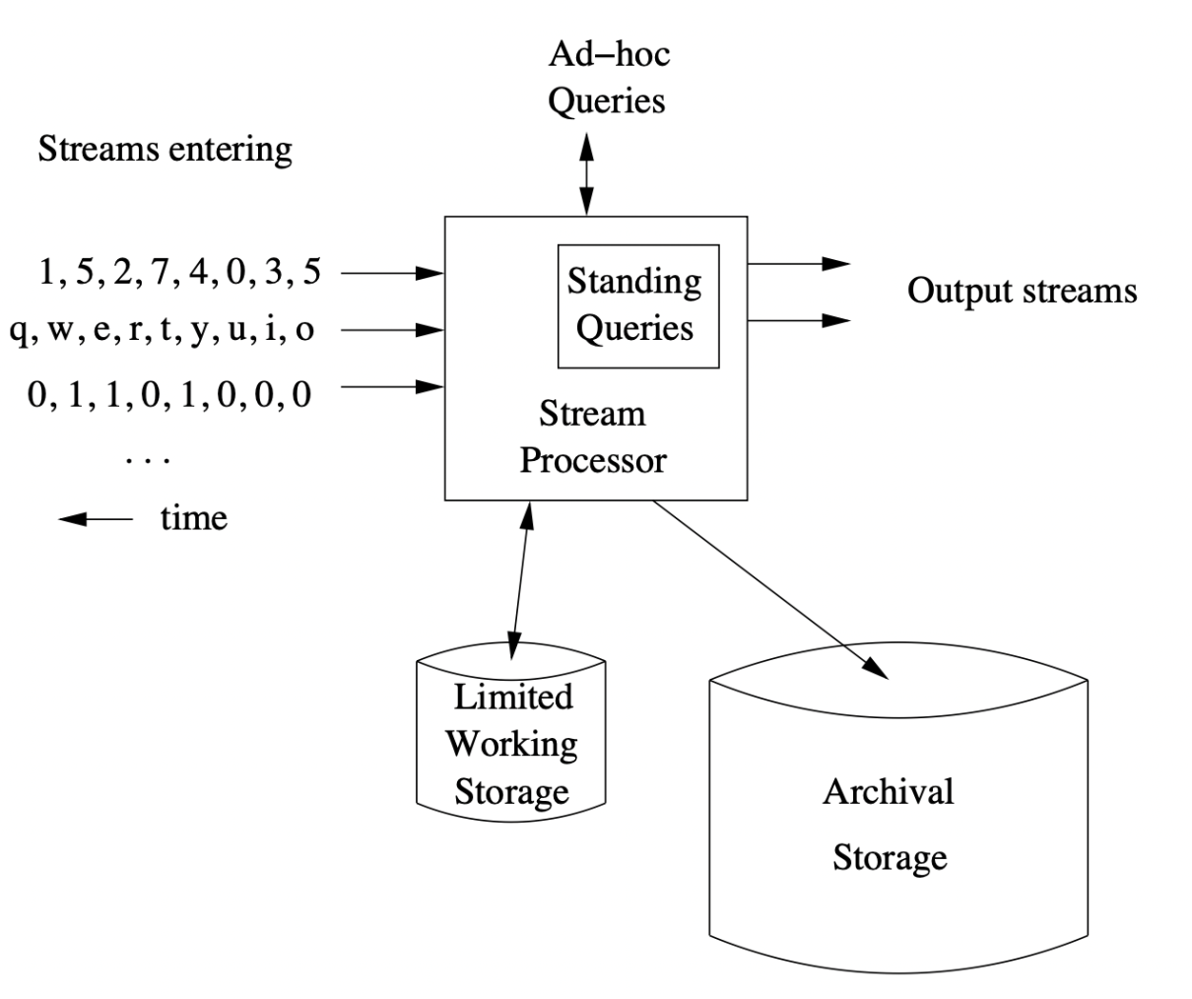
UNIT 4 - Data stream Model

Slide 4
UNIT 4 –Data stream Model
Multiple input streams arrive continuously (numbers, text, bits).
Each incoming event is accepted by the Stream Processor as soon as it arrives. The processor reads the event metadata.
The processor determines the time model it will use: processing-time (when it was seen) or event-time (the event’s own timestamp).
  A Stream Processor handles them in real time using:
  Limited Working Storage → small in-memory state (windows, counters, sketches).
  Standing Queries → continuous queries running all the time.
  Ad-hoc Queries → one-time user queries.
  Archival Storage → long-term data history for batch/offline analysis.
  Processor updates state, applies queries, and produces output streams.

